Slide 1

Predicting Major League Baseball Playoff
Roy Pyo

Slide 2
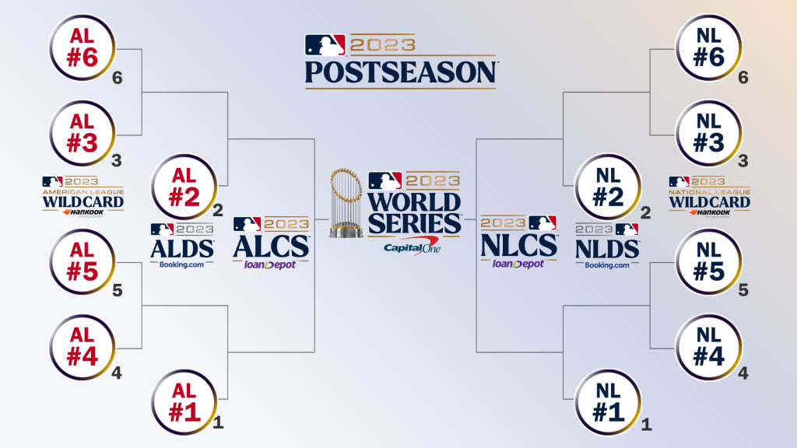
MLB Postseason Bracket
Every year, MLB plays 162 regular-season games for each team. There are four divisions in each league: the American League and the National League. The team with the most wins from each division goes directly to the playoffs.
The last 2 spots for the playoffs are decided by winning percentage. In total, 6 teams go to the playoffs.

Slide 3
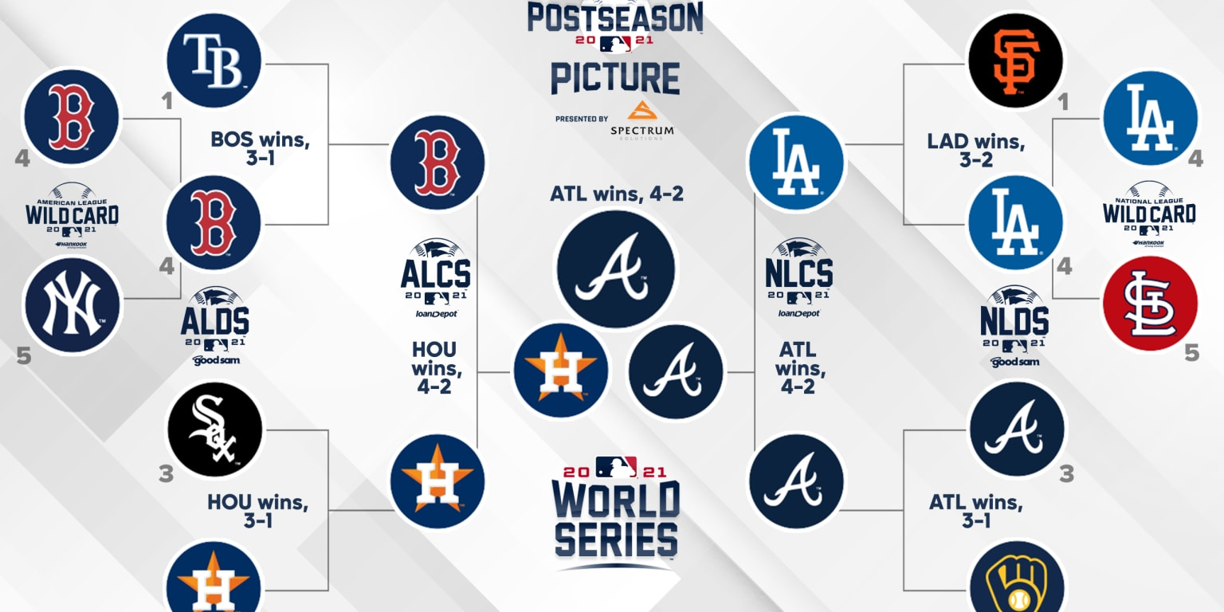
Project Goal
The goal is to predict which teams make playoff through 5 classification models (Logistic Regression, k-Nearest Neighbors, Random Forest , XGBoost, and Support Vector Machine) given a slew of input features related to each team’s hitting/pitching/fielding.
This is important because it can help every team rebuild their roster after the season. When they trade players, they can analyze which parts of the team's statistics are lacking for playoff contention and make informed decisions on trades.

Slide 4
Dataset Info
The original dataset contains 2985 observations and 48 columns of team statistic information.
Additionally, I included several more advanced statistics that are now utilized in the games, along with other important features that help evaluate the team more accurately.
The MLB faced closures in 1994 due to a player strike and in 2020 due to the COVID-19 pandemic, resulting in the exclusion of these seasons from the dataset. These events underscore the sport's adaptability to external challenges.

Slide 5
Feature Engineering (Hitting)
### [Hitting]
OBP: On-Base Percentage (The percentage of plate appearances resulting in the batter reaching bases)
SLG: Slugging Percentage (A measure of the team's power-hitting ability, calculated as total bases divided by at-bats)
TB: Total Bases (The sum of bases earned through singles, doubles, triples, and home runs)
OPS: On-Base Plus Slugging (The sum of OBP and SLG)
GPA: Gross Production Average (A measure of a player's overall offensive production, combining OBP and SLG)
TA: Total Average (A metric considering total bases, walks, hit by pitch, stolen bases, and other factors per plate appearance)
PSN: Power-Speed Number (A combined measure of player's home run and stolen base proficiency)
ISO: Isolated Power (A measure of a team's raw power, calculated as SLG minus BA)
BABIP: Batting Average on Balls in Play (The ratio of walks and hit by pitch to toal at-bats)

Slide 6
Feature Engineering (Pitching)
### [Pitching]
WHIP: Walks plus Hits per Inning Pitched (A measure of a pitcher's effectiveness in preventing baserunners)
BAA: Batting Average Against (The opposing batters' batting average against the team's pitchers)
K/BB: Strikeouts per Walk (The ratio of strikeouts to walks, indicating a pitcher's control and dominance)
BB/HBP_ratio: Walks and Hit by Pitch Ratio (The ratio of walks and hit by pitch to total at-bats)
IP: Inning Pitched (The total number of innings pitched by the team's pitchers, converted from outs)
### [Team]
P%: Power Percentage (The percentage of runs squared divided by the sum of runs squared and runs allowed squared, providing a measure of a team's power)
WP: The ratio of wins to total games played, indicating the team's winning rate.

Slide 7
EDA

Slide 8
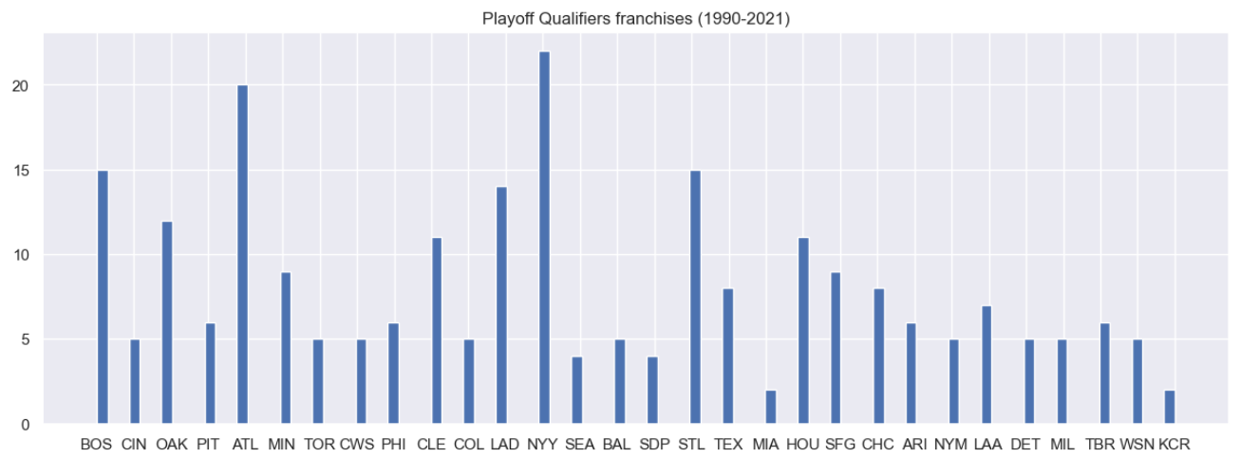
Playoff Qualifiers by Franchise
The figure indicates that the New York Yankees qualified for the playoffs the most (over 20 times), followed by the Atlanta Braves (about 20 times). On the other hand, the Miami Marlins and Kansas City Royals appeared the least, only making it to the playoffs twice.

Slide 9
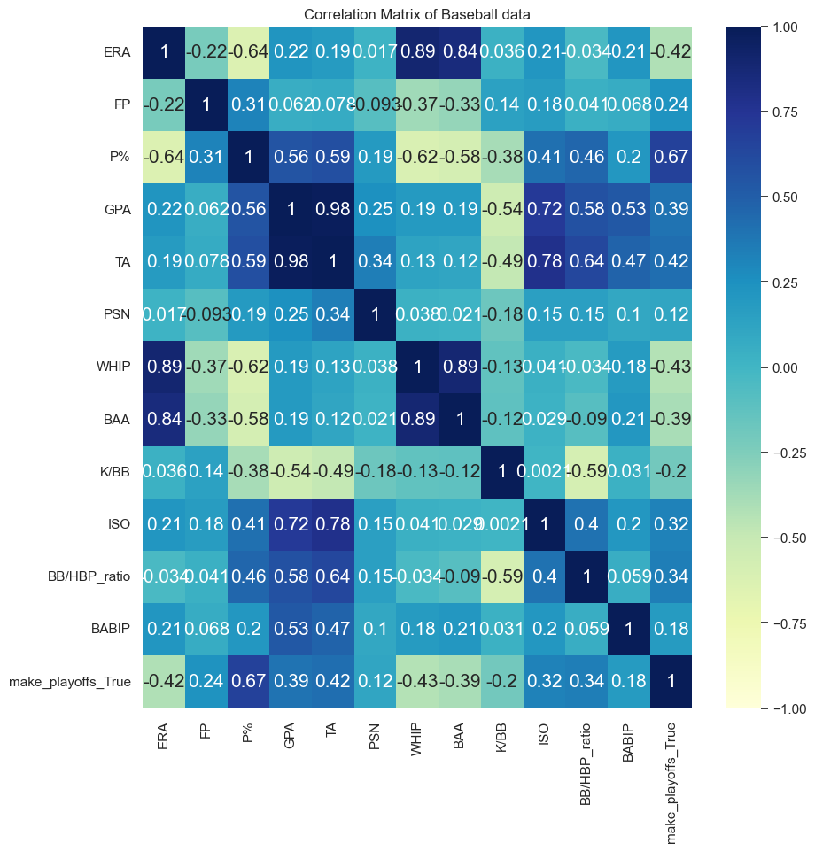
Correlation Matrix
Following the correlation analysis, the statistic P%, which measures a team's power, shows the highest correlation with making the playoffs. Conversely, ERA, WHIP, and BAA exhibit negative correlations with playoff qualification. This underscores the significant impact of pitching statistics on a team's ability to make the playoffs.

Slide 10
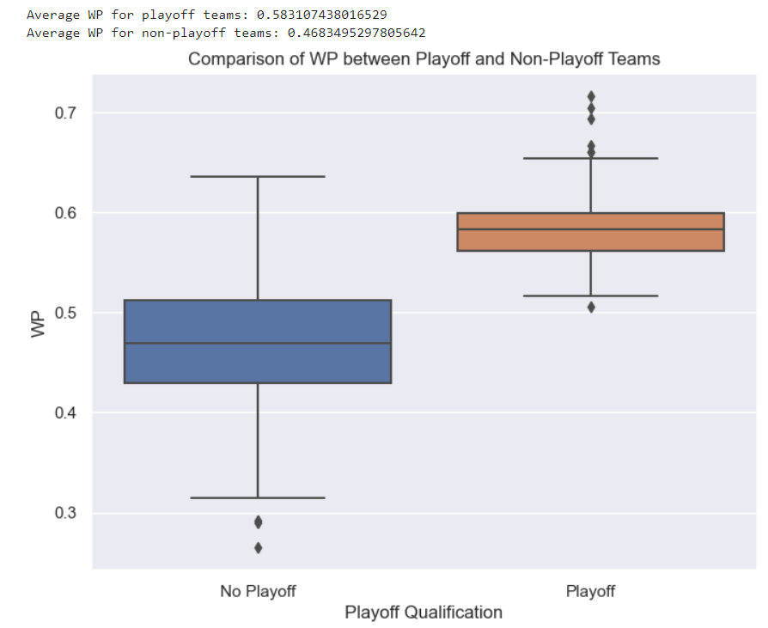
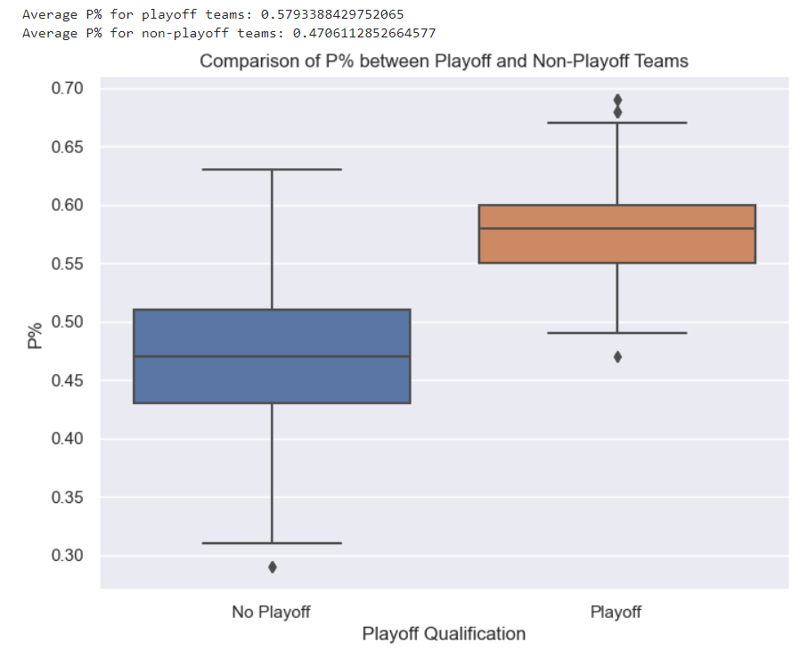
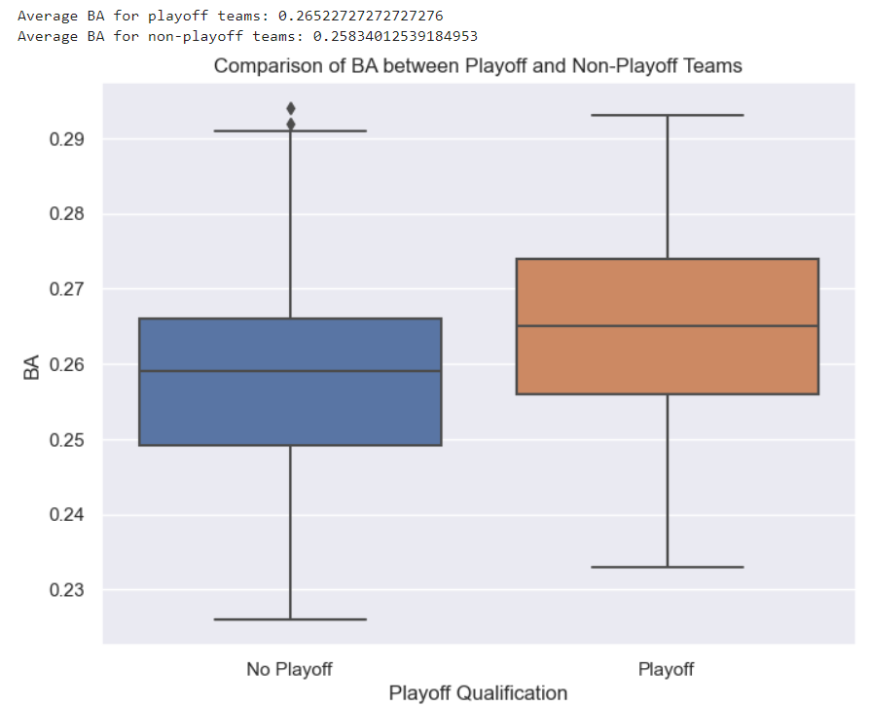
Comparisons between Playoff Qualified teams vs Non Qualified teams

Slide 11
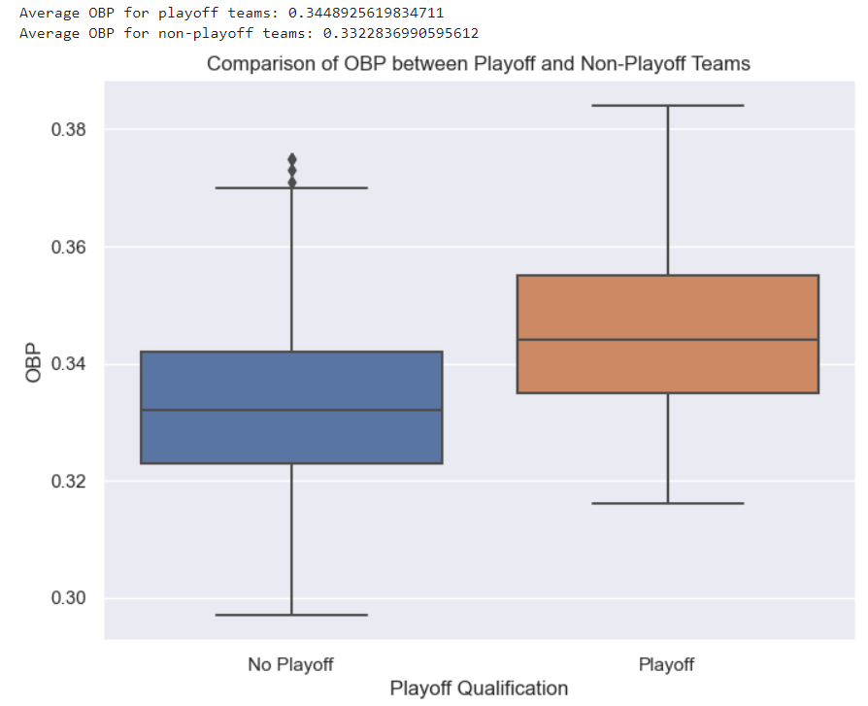
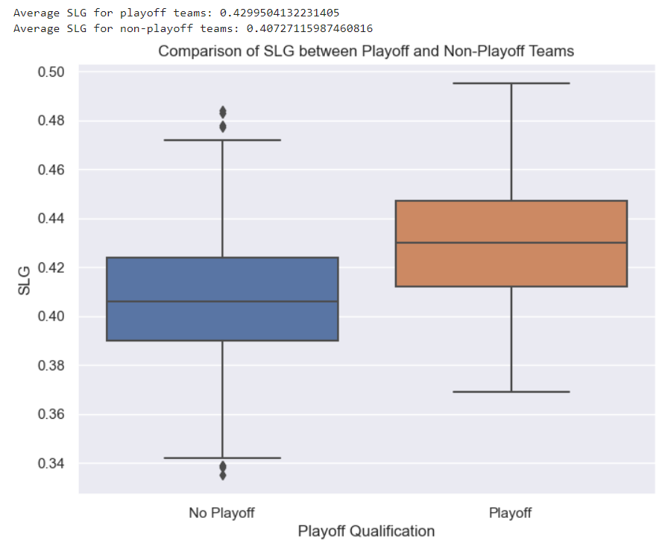
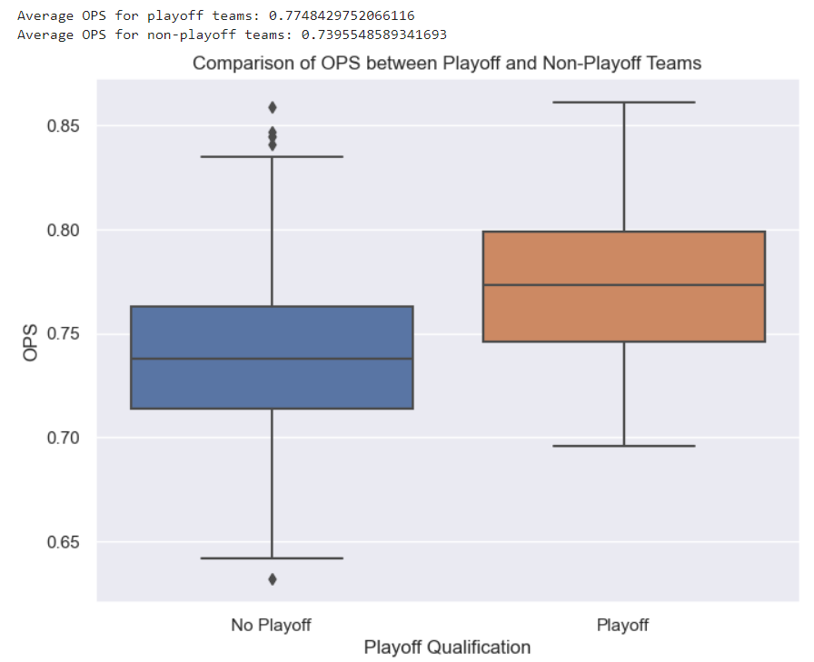
Comparisons between Playoff Qualified teams vs Non Qualified teams

Slide 12
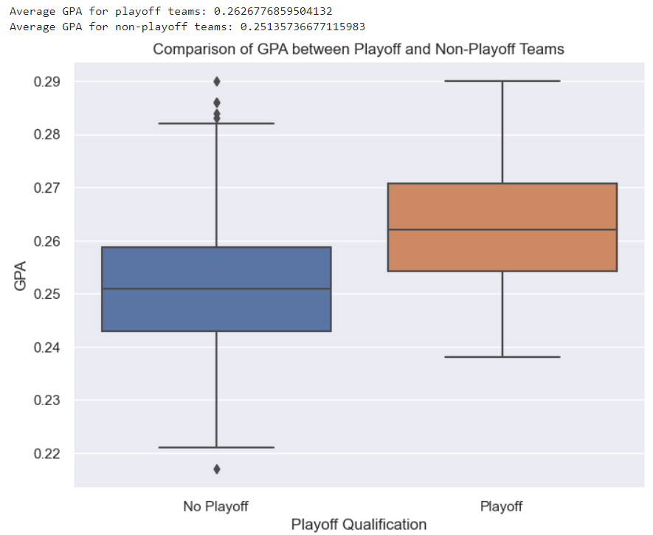
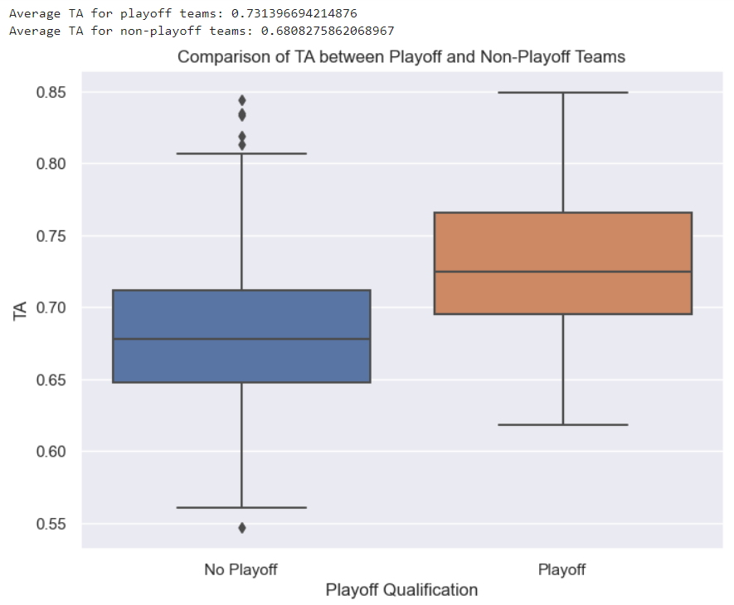
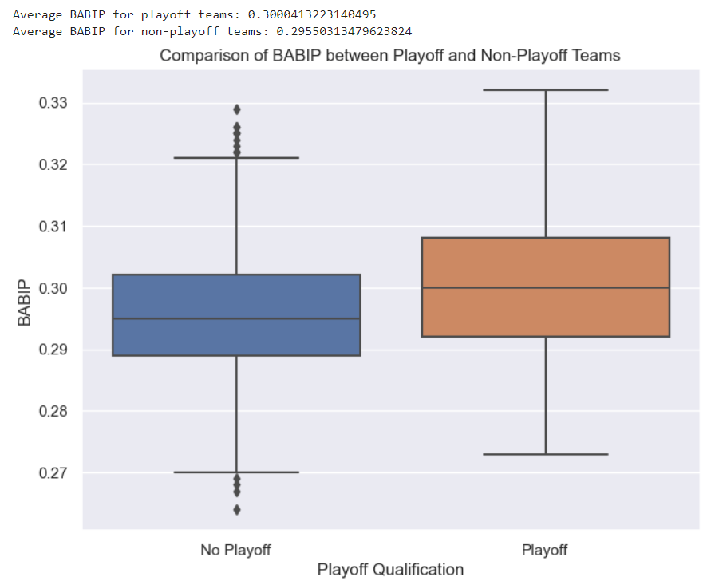
Comparisons between Playoff Qualified teams vs Non Qualified teams

Slide 13
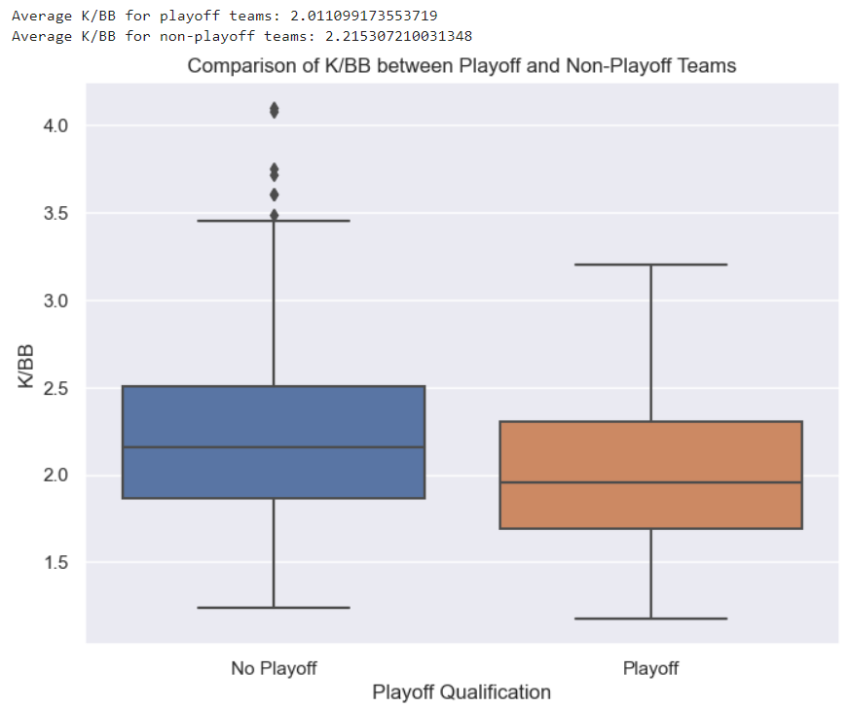
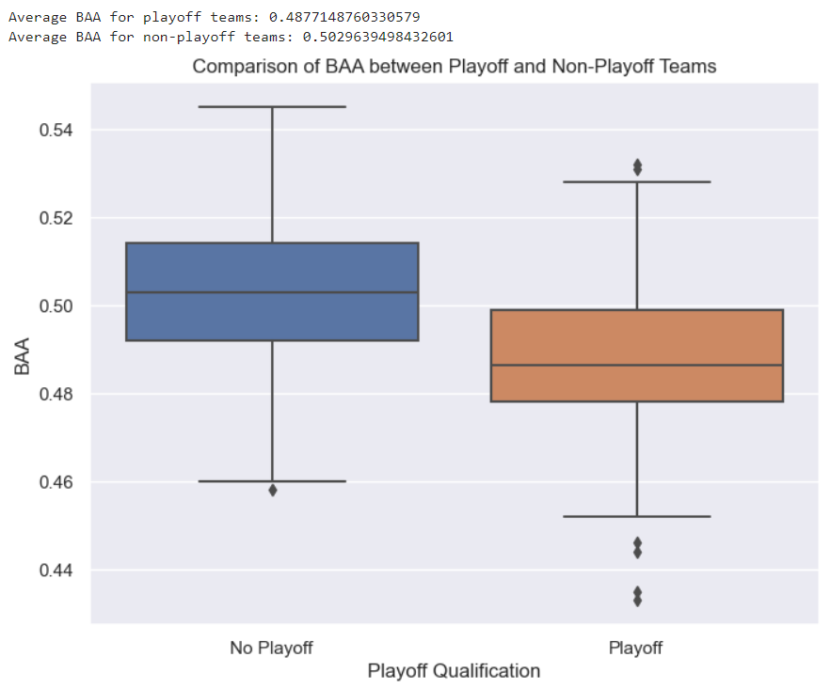
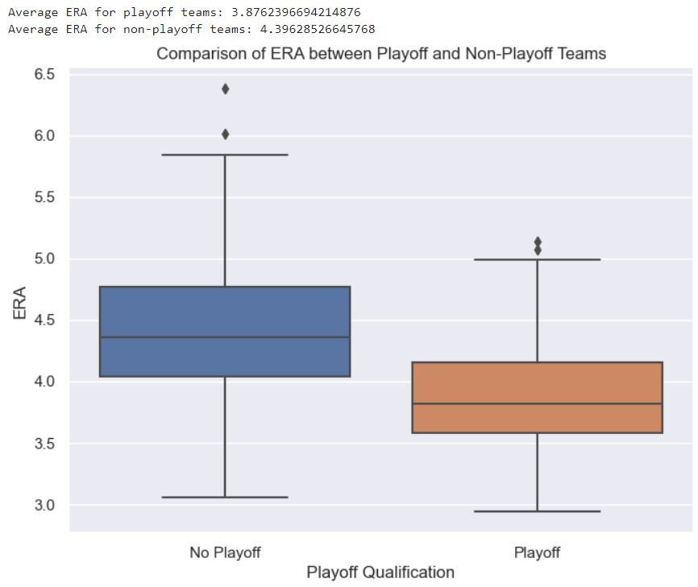
Comparisons between Playoff Qualified teams vs Non Qualified teams

Slide 14
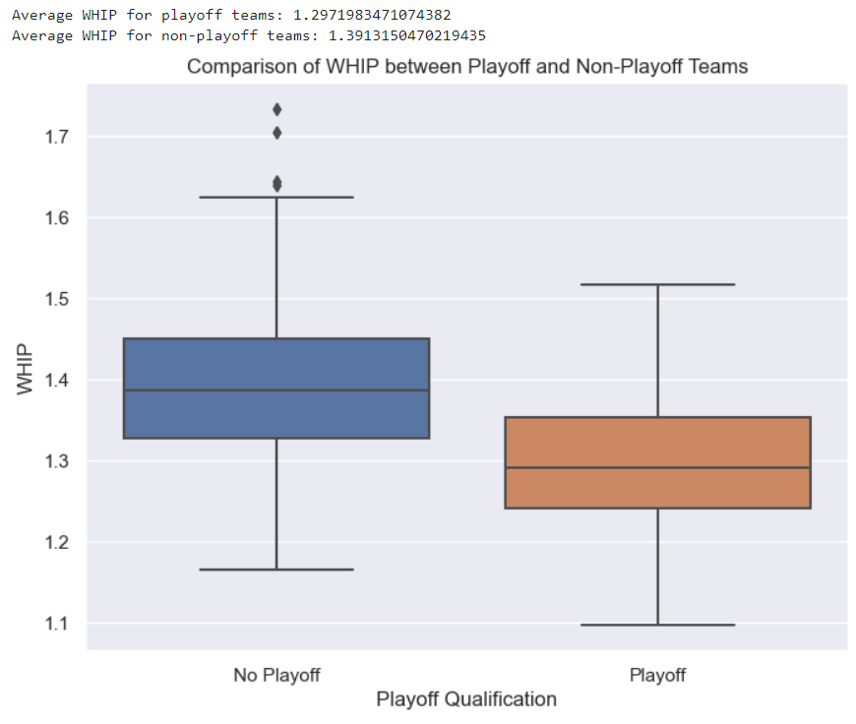
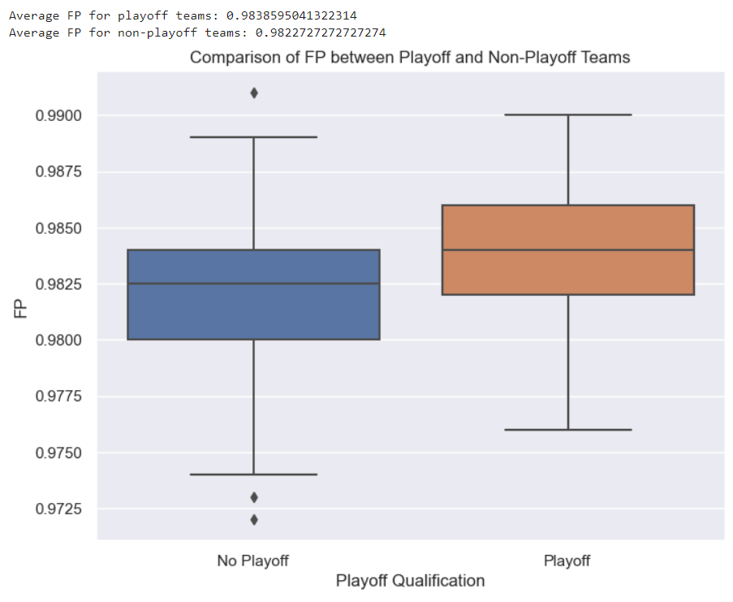
Comparisons between Playoff Qualified teams vs Non Qualified teams

Slide 15
Pre-Processing Steps

Slide 16
Data Pre-Processing
There were 7% missing values in the dataset.
Most of the missing values were due to changes in team names resulting from relocation or other issues.
As previously mentioned, the 1994 and 2020 seasons were excluded due to their shortened nature, which could introduce noise into the analysis.
The Wild Card game was established starting from the 2012 season.
Additionally, a few more advanced statistics for hitting, pitching, and fielding were added to the dataset.

Slide 17
Pre-Processing for Model Build-Out
The new data frame contains 880 observations with 13 columns, totaling 11,440 data points.
Even though there are enough observations for a train-test split without resampling, due to the limited number of observations, 10-fold cross-validation resampling will be used for more robust model evaluation.
To achieve this, the following steps can be taken:
Remove columns that are highly correlated, categorized, or not meaningful for the model.
Perform 10-fold cross-validation resampling for model evaluation.
This approach ensures that the model is adequately trained and tested on the available data while accounting for the limited number of observations.

Slide 18
Model Build-Out

Slide 19
Model Descriptions
Logistic Regression
Random Forest Classifier
XGBoost
Support Vector Machine
K-Nearest Neighbors(KNN)

Slide 20
Model Assumptions
Random Forest Classifier : Non-parametric, normality not needed. Predictions from each tree have low correlations.
XGBoost : Non-parametric, normality not needed. Tree based ensemble method. Easily handle non-linear relationships between variables.
Support Vector Machine : Parametric, Distance from the classification boundary to the nearest data point should be large.
K-Nearest Neighbors(KNN) : Non-parametric, no distributional assumptions needed. Data points exist in close to each other are similar.

Slide 21
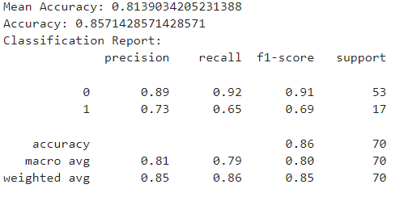
Logistic Regression Results
Confusion Matrix
49 | 4
6 | 11

Slide 22
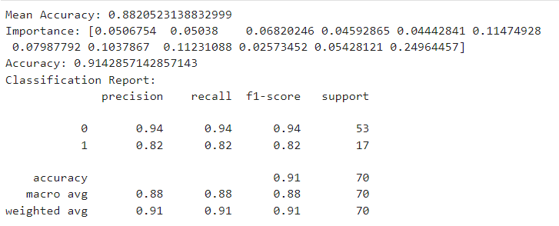
Random Forest Results
Confusion Matrix
50 | 3
3 | 14

Slide 23

XGBoost Results
Confusion Matrix
49 | 4
5 | 12

Slide 24
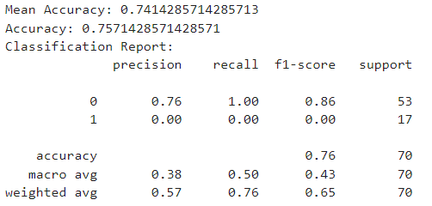
SVM Results
Confusion Matrix
53 | 0
17 | 0

Slide 25
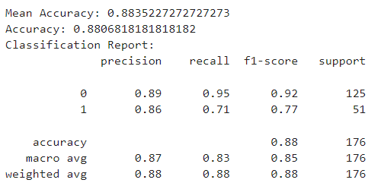

KNN Results
Confusion Matrix
119 | 6
15 | 36

Slide 26
Overall Results
Overall Accuracy
Logistic Regression | 0.857
Random Forest | 0.914
XGBoost | 0.871
SVM | 0.757
KNN | 0.880

Slide 27
Conclusion

Slide 28
Variable Importance
Variable Importance Features
Logistic Regression | 'BB/HBP_ratio', 'K/BB', 'BAA', 'BABIP', 'TA', 'GPA', 'ERA', 'WHIP', ‘ISO’, ‘P%’
Random Forest | 'BB/HBP_ratio’ : 0.05
 | 'K/BB’ : 0.05
 | 'BAA’ : 0.07
 | 'BABIP’ : 0.05
 | 'PSN’ : 0.04
 | 'TA’ : 0.11
 | 'GPA’ : 0.08
 | 'ERA’ : 0.10
 | 'WHIP’ : 0.11
 | 'FP’ : 0.03
 | ‘ISO’ : 0.05
 | ‘P%’ : 0.25
Logistic regression is favored for its simplicity in modeling. From the variable importance analysis using Logistic regression, most features were selected except 'PSN' and 'FP'. 'PSN' is related to home runs and stolen bases, which can be assumed to be correlated with 'Runs'.
On the other hand, Random Forest exhibits the highest accuracy, with 'P%' identified as the most important feature in the model. This observation aligns with the high correlation observed in the heatmap for this variable.

Slide 29
Conclusion/Limitations
For the accuracy, Random Forest has the highest accuracy and SVM has the lowest accuracy
P% has the highly correlated to make playoff
Pitching Stats such as EPA, WHIP and BAA has the negative impact on making playoff
Limitations
Small sample size
Difficulty in comparing the two teams individually in the playoff, therefore it is hard to predict which team will advance to the World Series and ultimately become the world champion.
Future Research
To overcome the limitation, gather more data and explore more advanced stats
Finding methods to compare the two teams in the playoff to predict which team will win the game and advance to the world series and become the world champion.

Slide 30
Thank You
Q&A

